Slide 1

Acoustic Imaging
Nick Snyder

Slide 2
Timeline
Overview of Acoustic Imaging
History
Different Types of Acoustic Imaging
Scanning Acoustic Microscopy (SAM)
Sonar
Medical Ultrasound
Airborne Ultrasound Imaging
Mainstream Acoustic Imaging Devices

Slide 3
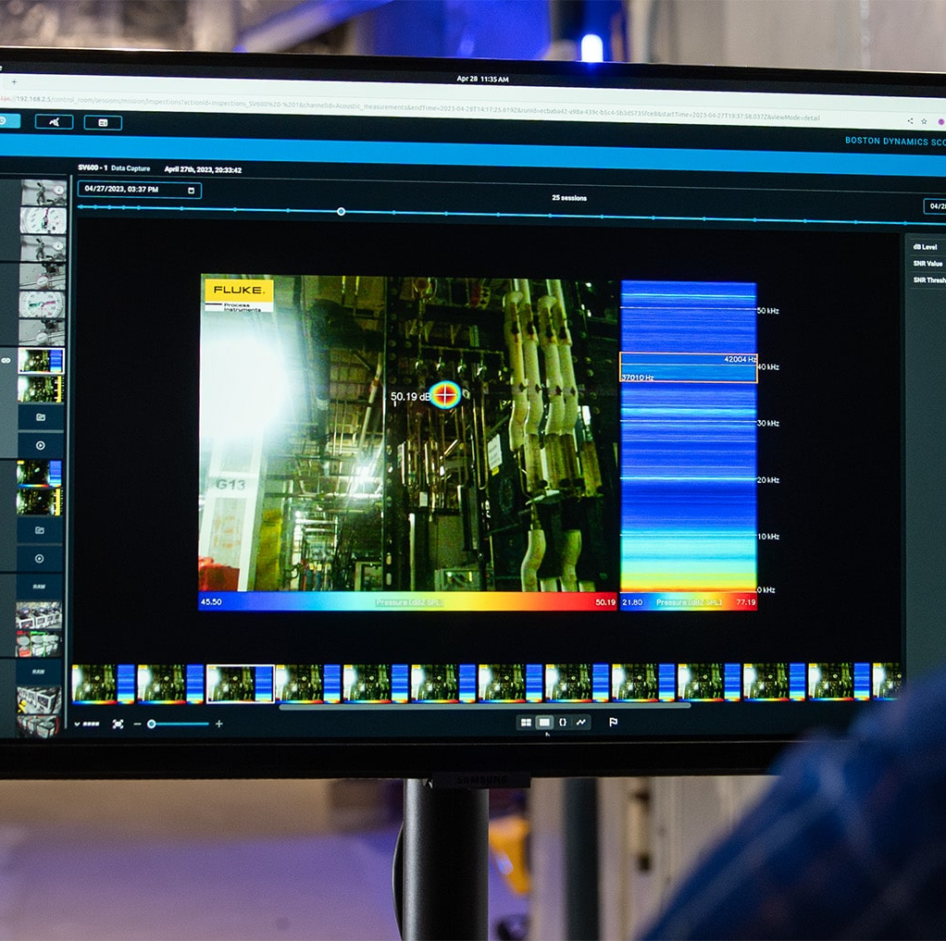
What is Acoustic Imaging?
Visualize sounds
Sonar
Transducer
Array of microphones
Beamforming

Slide 4

History
Hippocrates
Leonardo Da Vinci
Cymatics
Lord Rayleigh
Hydrophones
Camera integration

Slide 5
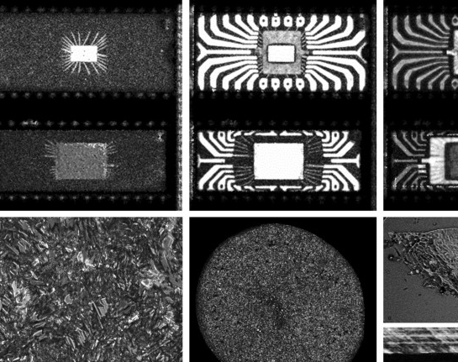
Scanning Acoustic Microscopy (SAM)

Slide 6
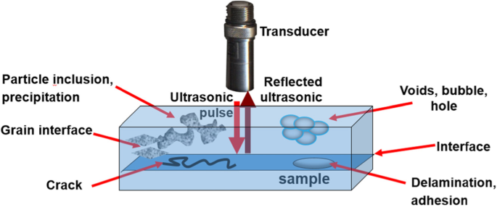
What is SAM?
Product inspection
Quality control
Counterfeit detection
Precision

Slide 7
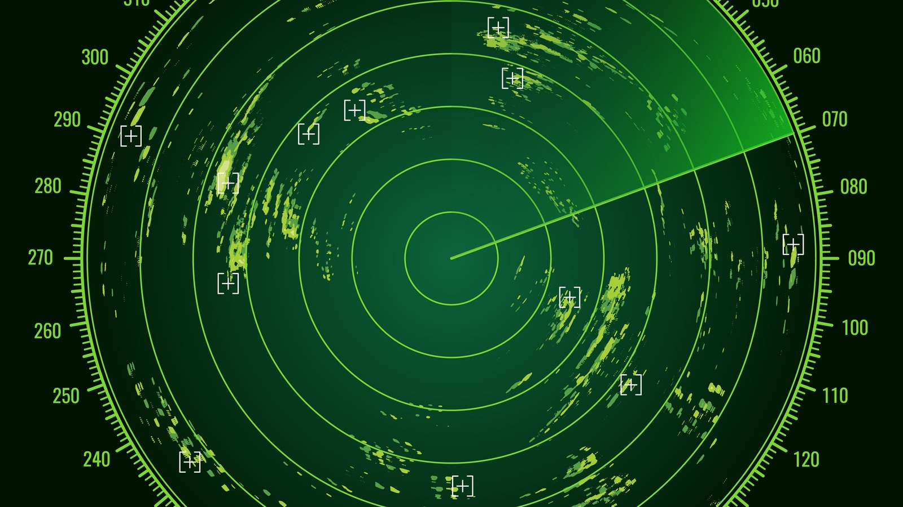
Sound Navigation And Ranging (SoNAR)

Slide 8
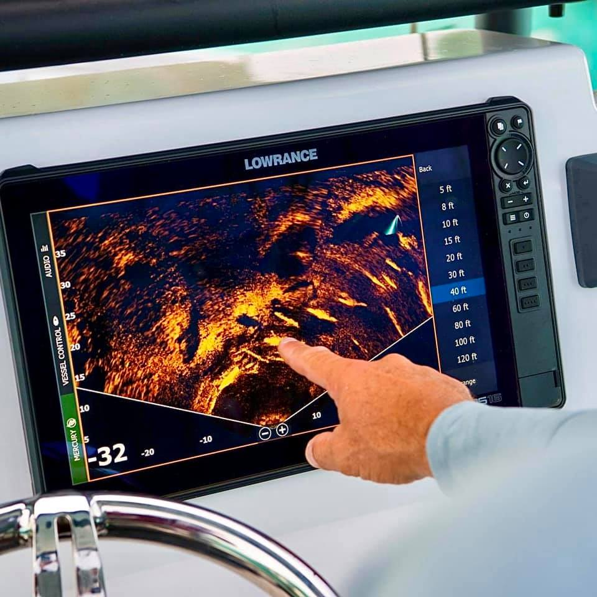
What is Sonar?
Like echolocation
Military uses
Passive vs. Active
Dangers to nature
Titanic
Fishfinder

Slide 9
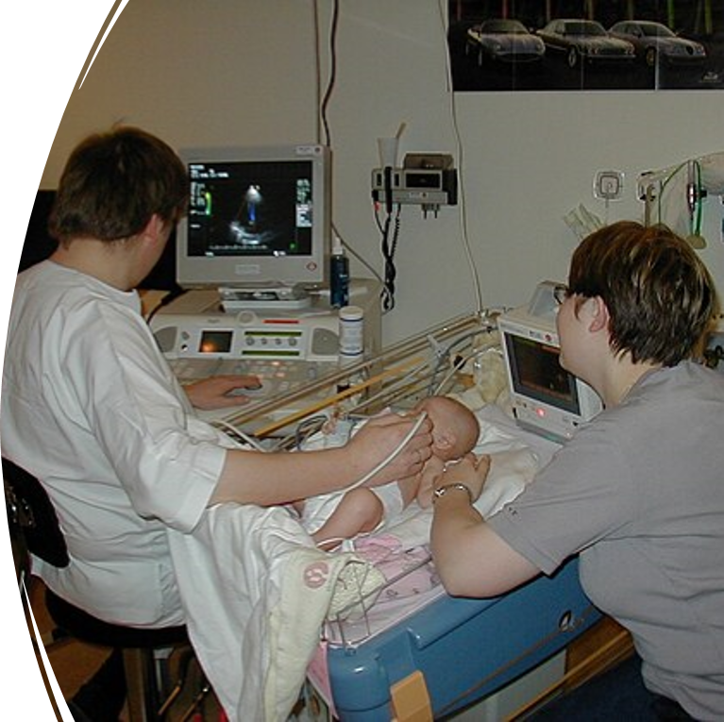
Medical Ultrasound

Slide 10
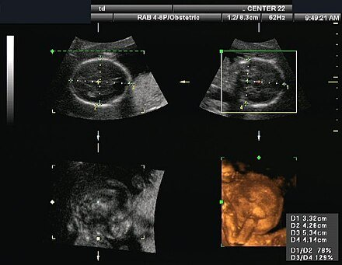
What is ultrasound?
A, B, C, M modes
Handheld transducer
1-18 MHz
Biomicroscopy

Slide 11
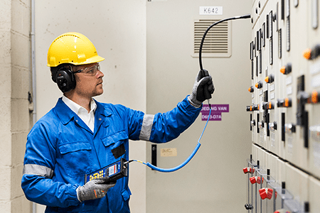
Airborne Ultrasound Imaging

Slide 12
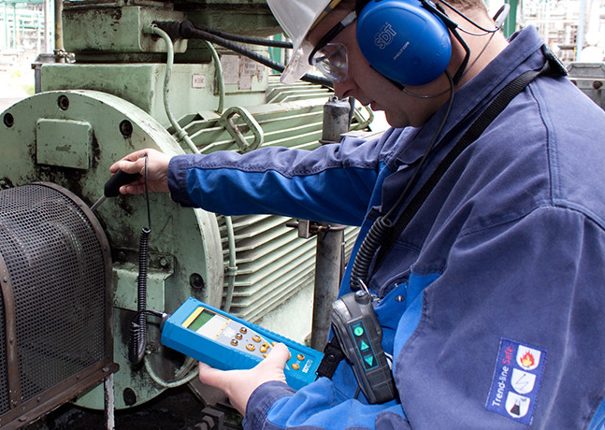
What is it?
Microphone array
Hearing range
Audio/Visual feedback
Leak detection

Slide 13
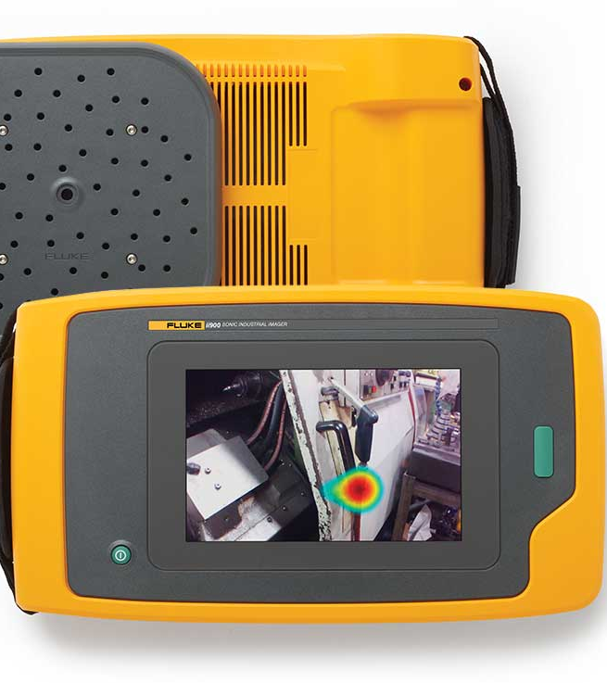
Acoustic Imaging Devices Today
Fluke ii910 Precision Acoustic Imager
Price $28.5k
Frequency band: 2 Hz – 100 kHz
Effective range: 0.5 - 120 m
64 Microphones

Slide 14
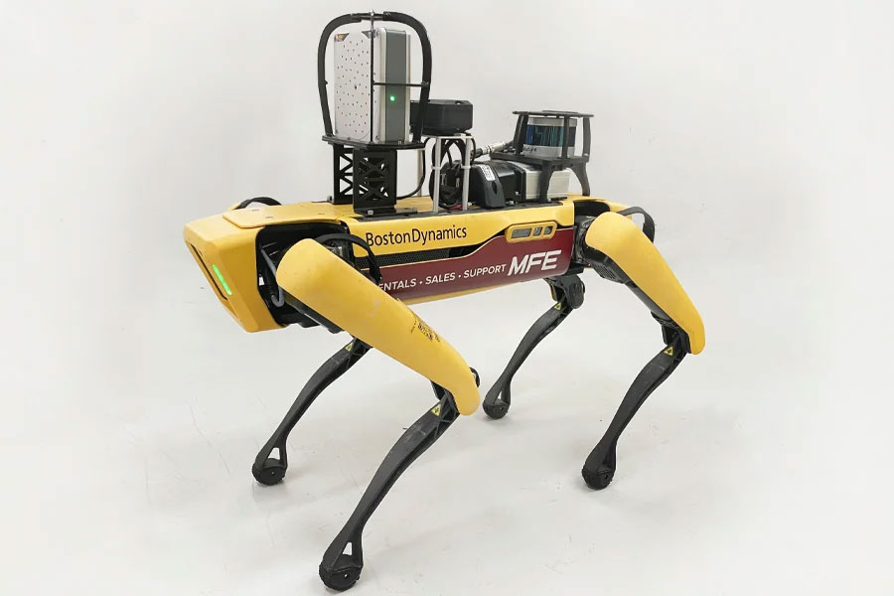
Applications of Acoustic Imaging
Automated plant monitoring
Hazardous area surveillance

Slide 15

The End

